Slide 1

Creating Accessible PDF Documents with Signatures
Five (ish) Steps for Accessible MOUs

Slide 2
Agenda
Compliant Documents
Prep in Word
Title
Add Signature Lines
Convert to PDF
Check your work
Resources & Questions

Slide 3
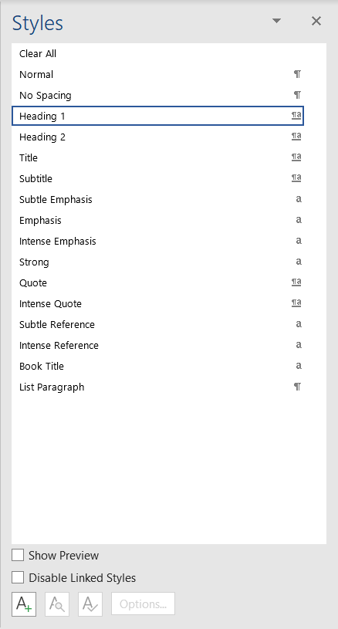
Step 1: Title It!
Use Heading 1 styling
Create a title
Add to metadata

Slide 4
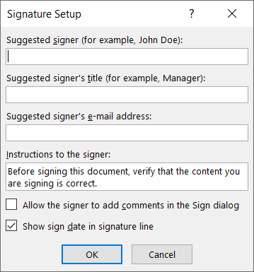
Step 2: Add Signature Lines
4
Choose Insert > Signature Line > Microsoft Office Signature Lines
Fill in the info
Ensure sign date checkbox is selected

Slide 5
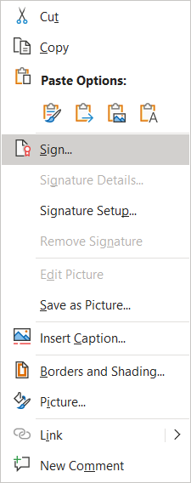
Step 3a: First Signature
5
Activate the context menu (right click) of the signature block
Draw your signature or use an image
Your credentials are saved in the block along with the date
Save document, change filename slightly
Send to second recipient

Slide 6
Step 3b: Second Signature
6
Save file locally and open it
Use Signature Bar at top of page to sign
Select the View Signatures Button
Your credentials are saved in the block along with the date

Slide 7
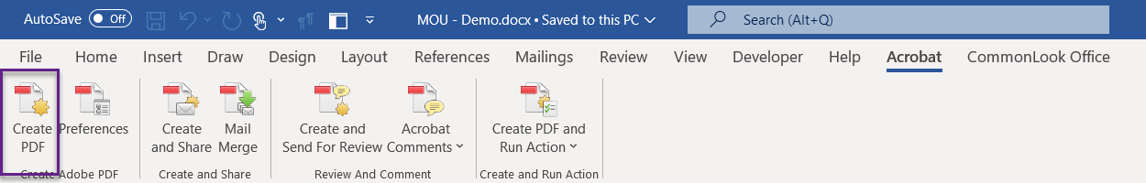
Step 4: Create PDF
Use the Acrobat Ribbon to create the PDF
Do NOT use Print to PDF or Save As PDF

Slide 8
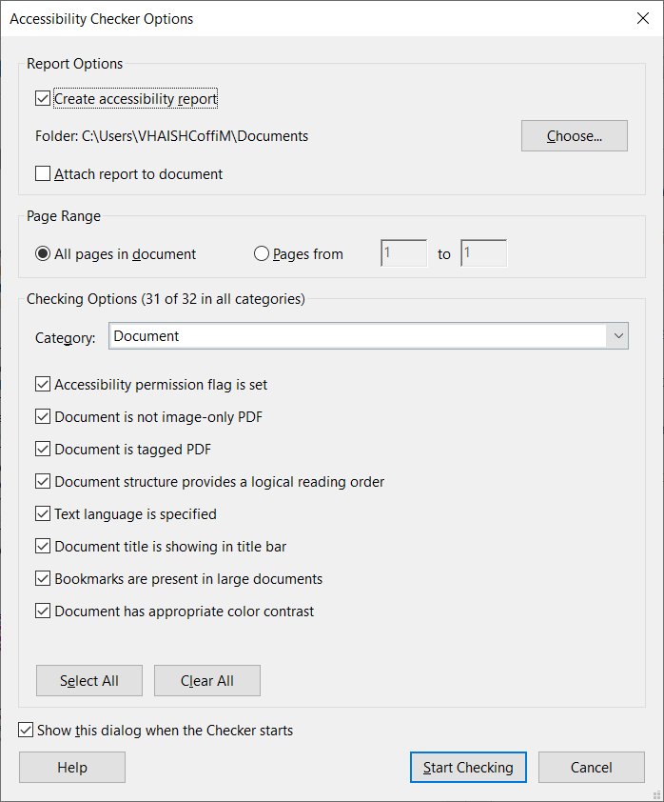
Step 5: Check Your Work
Office 365 includes an Accessibility Checker
Choose View > Tools > Accessibility
The document is accessible if no errors are produced in the report
There will be two manual checks always listed on the report
Color Contrast
Reading Order
Update signature alt text to get the A+

Slide 9
Resources
VA Section 508 Website https://vaww.section508.va.gov section508@va.gov
What is Section 508 and Why is it Important? TMS ID 4565345 https://www.vaitcampus.com/classroom/ondemand/33715
How to Get CommonLook Tools https://vaww.section508.va.gov/Desktop_Productivity_Tools.asp
How to Get Assistive Technologies (Screen Readers, Magnifiers etc) https://vaww.section508.va.gov/Assistive_Technology_Tools.asp
CommonLook PDF Training & Creating Accessible PDFs Training https://vaww.section508.va.gov/Training_Accessible_Documents.asp#pdfaccess
Register for CommonLook PDF Training, Part 1 on TMS (1st Wed/Thurs of the month)
Register for CommonLook PDF Training, Part 2 on TMS (2nd Wed/Thurs of the month)
WebAIM: Contrast Checker | Nerdery
Section 508 Gov website https://www.section508.gov/create/documents/training-videos/
CommonLook PDF Training & Creating Accessible PDFs Training https://vaww.section508.va.gov/Training_Accessible_Documents.asp#pdfaccess
Register for CommonLook PDF Training, Part 1 on TMS (1st Wed/Thurs of the month)
Register for CommonLook PDF Training, Part 2 on TMS (2nd Wed/Thurs of the month)
CommonLook Office Training & Creating Accessible Word Documents Training https://vaww.section508.va.gov/Training_Accessible_Documents.asp#wordaccess
Register for CommonLook Office Training on TMS (3rd Wed/Thurs of the month)
One-on-One (Small Group) Training – Bring Your Own Document (BYOD) https://vaww.section508.va.gov/Training_One_on_One.asp
Register for BYOD sessions (Various days and times)
DigitalVA Accessibility Guide https://digital.va.gov/accessibility/getting-started/

Slide 10
It’s been a pleasure!
Thank you for this opportunity!

